Slide 1
Post-Stroke Care Delivery in a Tertiary Hospital System in Bangalore, India: the Global Stroke Management Implications
Rasa Nikooifard & Sona Ghaebi
MPH Student in BIHE
Enrolled in Global Surgery and Social Change Program
Boston Children’s Hospital
Harvard Medical School
Narayana Health
Bahá'í Institute of Higher Education (BIHE)

Slide 2
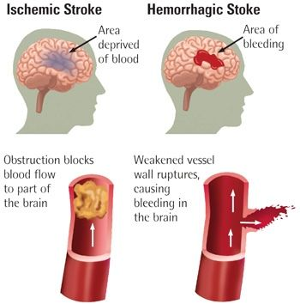
Introduction
Stroke is an acute injury to brain tissue caused by:
either sudden blockage of blood vessels resulting in ischemic stroke
or rupture of blood vessels resulting in a hemorrhagic stroke (1).

Slide 3

Stroke-related incidences of disabilities are frequent among the survivors. As the third most common cause of disability worldwide, stroke causes about 113 million DALYs and is responsible for about 5% of all morbidity (2).
Worldwide, acute ischemic strokes account for 71% of all stroke cases. (2 , 3).
Ischemic stroke is a significant contributor to the stroke-related DALYs (58%), representing 67% of new cases and 51% of all stroke deaths (2).

Slide 4
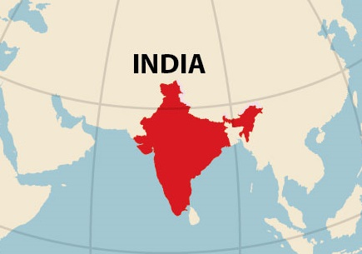
The incidence of stroke in India has been doubled compared between the 1970s and 2000-2008 (4).
In 2013, stroke-related DALYs in India were reported to be about 795/100,000 person-years (5).
The most common ischemic stroke risk factors in India are hypertension (60.8%), diabetes mellitus (35.7%),
and tobacco use (32.2%) (6).

Slide 5
However, challenges of recording and storing patient data registry combined with close-to-impossible retrieving the recorded data contribute to a lack of research on patient outcome, especially in resource-constrained settings in LMICs.
This is a unique multi-institute and international collaboration. Our teams, worked through the challenges to improve the data collection and data analysis approaches among each respective institutes.
In this paper, we present the experience of Narayana Health hospital networks in Bangalore, India. The dataset in this study is surprisingly unique in regards to the longitude, volume, and comprehensiveness of patient data available in LMICs.

Slide 6

Our main goal has been not only to elucidate stroke care delivery in an LMIC but also to pursue global health equity.
For instance, the burden of morbidity and mortality is not uniformly distributed among countries and income groups.
A significant discrepancy exists. In low- and middle-income countries (LMICs), 84% of patients die within three years of the initial stroke episode, compared to only 16% in high-income countries (HICs) (7, 8,9).

Slide 7
The second layer of inequity exists between rural and urban populations in the world and also in India.
The prevalence of stroke is reported to be between 84-262/100,000 for rural populations and between 334-424/100,000 for urban populations in India(10).

Slide 8
Mortality and disability (reported in DALYs) related to stroke have been increasing in LMICs in contrast to the decrease in burden noted in HICs between 1990-2013 (11).
Part of the difference may be attributable to differences in access to therapy. There has been a recent rapid improvement in ischemic stroke treatment methods, from endovascular thrombectomy and thrombolysis (IV-tPA) (12, 13).

Slide 9
Across India, there are approximately 100 centers that provide rtPA treatment and 55 centers that are capable of performing mechanical thrombolysis, mostly provided by private healthcare centers (10).
Centers in India report a mortality rate of 7.9% in the first 90 days post-injury and a (mRS) score of 0-2 in 48% of 2066 patients (6).
According to two prospective studies in 2005 and 2007 performed in rural India and Kolkotta, 55-70% of stroke survival patients were fully independent by one-year post-treatment, respectively (14, 15) .

Slide 10
Methods
The Study was retrospective analysis of prospectively collected data of ischemic stroke patients at Narayana Health (NH) in Bangalore, India.
Data Collected by health care team regarding demographics, clinical presentation, and patient outcomes during patient admission, hospitalization, and clinical follow-up visits .
Data extracted from :
Existing clinical datasets
Admission registry
Patient charts
The admission characteristics to identify predictors of post-stroke death and functionality were analyzed.

Slide 11
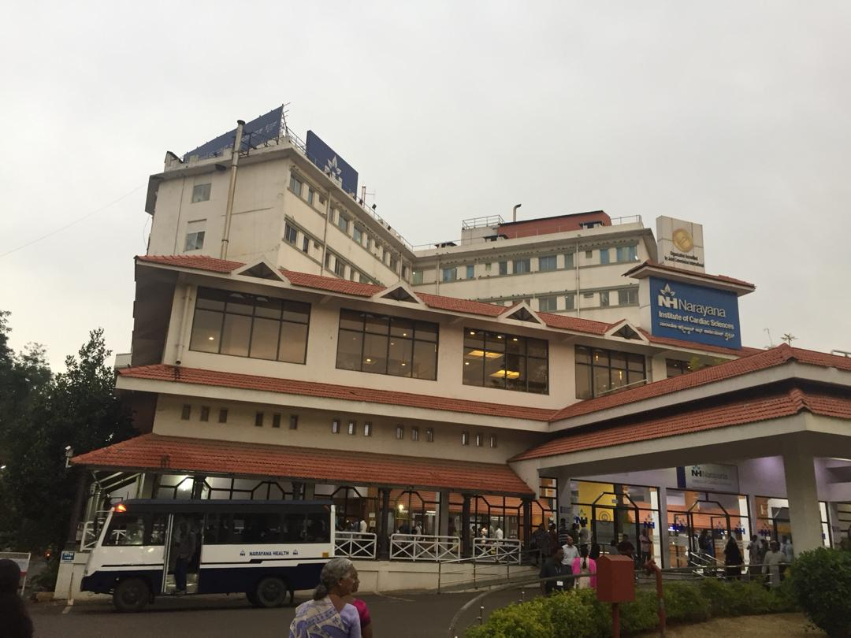
Care Setting
Narayana Health (NH) is the second largest hospital networks in India and emphasizes providing affordable health care to the Indian population. NH has 23 multi-specialty hospitals, primary care facilities, and health centers, as well as 5 dedicated stroke units.

Slide 12
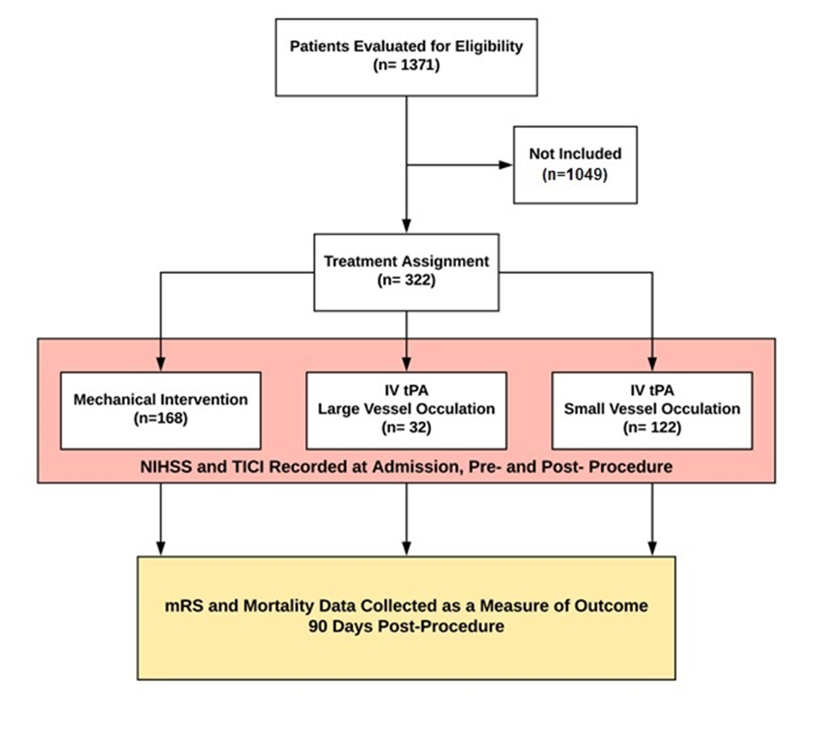
Study Population
The patient cohort includes male and female adults (>10 years of age) presenting with a diagnosis of acute ischemic stroke at NH, Bangalore from 2010 to 2018 (March 23).

Slide 13
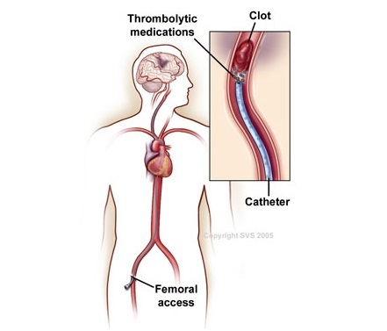
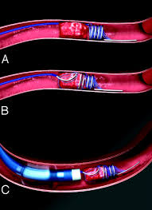
Acute Ischemic Stroke Treatments:
Intravenous thrombolysis ( IVT) is one of the standard treatment in ischemic stroke patient that presented within 4.5 h of symptom onset with the use of recombinant tissue plasminogen activator(rtPA)(16).
Mechanical thrombectomy is one of the most effective methods for saving brain tissue within 24 hours of stroke onset (17) .

Slide 14
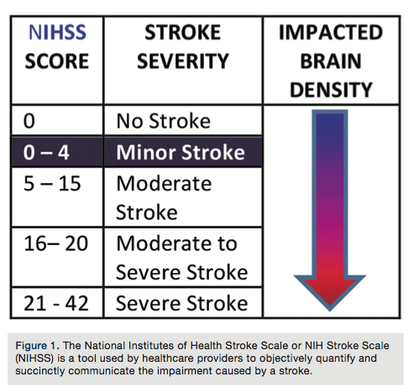
Baseline and Stroke Severity Characterization
NIHSS is agreed-upon initial assessment in the National Institutes of Health Stroke Scale.
1) NIHSS of patients upon arrival to NH were assessed by clinicians.
2) NIHSS of patients when they experienced either exacerbation or improvement of symptoms
3) Pre-procedure NIHSS value recorded
4) Patient complaints and self-reported symptoms
5) clinical examinations of the patients presentations recorded by physicians independently
6) CT imaging and MRI
7) Affected brain location

Slide 15
Treatment Assignment
Patients received different treatments based on standardized international protocols implemented by experienced clinicians. This clinical decision was made after evaluation of the patient’s symptoms, comorbidities, and clinical images.

Slide 16
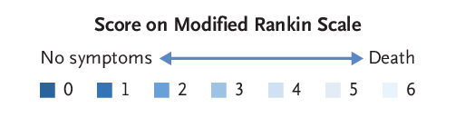
Clinical Assessment of Treatment Outcome
Patient survival and patient functionality measured by modified Rankin Scale (mRS).
The 90-days post-intervention mRS will be categorized in binary, favorable and unfavorable based on the three-month post-intervention mRS.
mRS disability score of ≤ 2 will define a favorable outcome
unfavorable outcome will be defined for mRS value of > 2.

Slide 17
Statistical Analysis
Patient demographic and clinical characteristic described by frequencies and percentages for categorical data and median and interquartile ranges for continuous data.
mRS values will be converted to dead/ dependent (mRS,3-6) as unfavorable and independent (mRS,0-2) as favorable (18).
All the statistical analysis is done using R statistical software (v3.5.1).

Slide 18
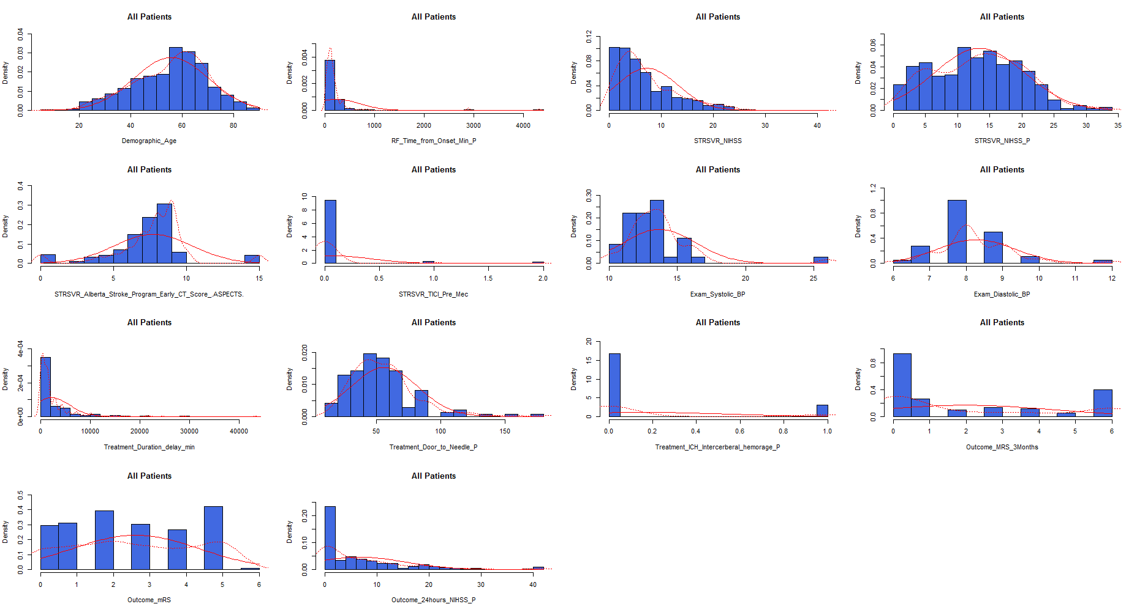
All Patients Numerical Variables’ distributions compared with Normal distribution

Slide 19
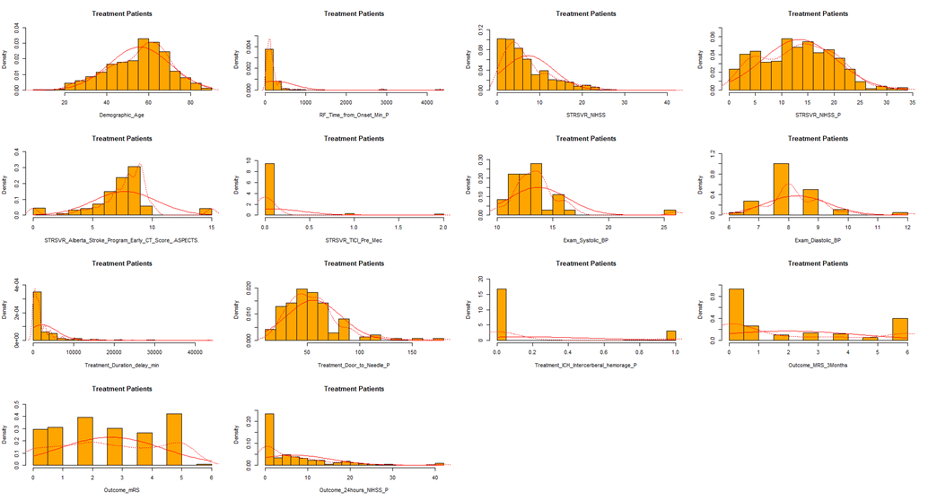
Treatment Groups Numerical Variables’ distributions compared with Normal distribution

Slide 20
Result
The average age of patients was 55.82(SD=14.45).
1007(73.5%) of patients have been male and 364 (26.5%) were female.
The most commonly reported comorbidities were hypertension (82.4%), diabetic patients (58.9%) and smoking history (17.4%).
The median for time form onset is 120 minutes.
For 439(38.5%) of cases NIHSS result of patients at arrival time is severe and for 700(61.5%) was not severe.

Slide 21
The NIHSS result after procedure (less than 24 hours) in 240(75.0%) of patients was severe and in 80(25.0%) was not severe.
Also the 24 hours NIHSS after procedure showed 85(35.3%) cases of severe and 156(64.7%) of not severe cases.
The median of treatment duration delay is 1440 minutes.
The 3 months mRS outcome for 193(65%) of patients was favorable and for 104(35.0%) of patients was unfavorable, with the median of 1.00
The most important cause of delay were 402(44%) cases of admitted outside referral, 183(20%) patient misinterpreted symptoms.

Slide 22
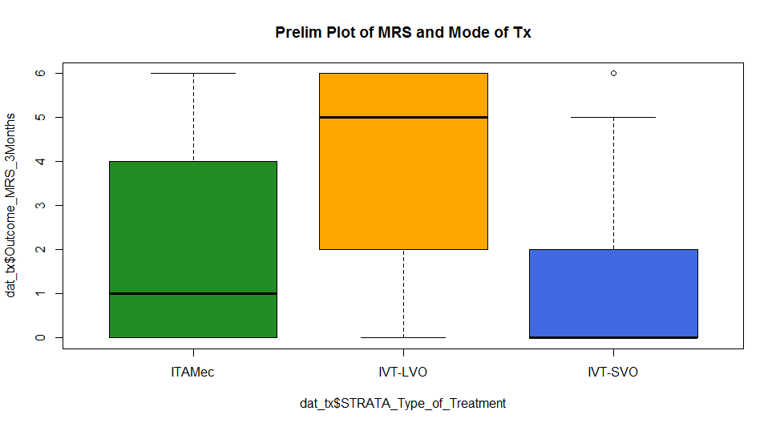
Difference of Outcome between Interventions

Slide 23
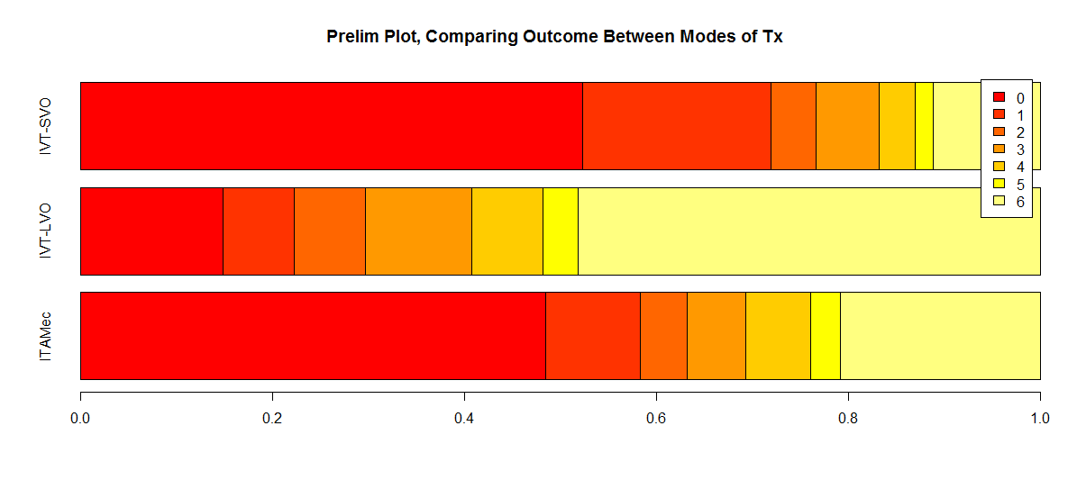
Difference of Outcome between Interventions (mRs)

Slide 24
Patient Safety and Procedure Complications:
No major complication related to IVT intervention was recorded in the patients’ registrar. One case was recorded as having developed an intracerebral hemorrhage status post mechanical intervention.

Slide 25
Discussion
Worldwide, acute ischemic strokes account for 71% of all stroke cases. (2,3).
Ischemic stroke is a significant contributor to the stroke-related DALYs (58%)(2).
From risk factors rheumatic heart disease, lipid and time of onsets that shows how many minutes passed from diagnosis symptoms has direct effect on treatment type.
Having access to enough facilities for reaching to tertiary hospital is one of the factors that influence mRS.

Slide 26
Study Limitations
Recall bias might be a concern as any self-reported symptoms might be affected by how the patients and their families recall the events.
Patients’ mRS is not measured, but for very few, when admitted.
As the data was gathered in long time duration and by different administration and surgical personnel, the data did not have a unique format so the number of missing data was significant.

Slide 27
Conclusion
Once again, our data elucidates on the importance of educating the target population regarding the symptoms and presentations of stroke and the vital role of early interventions, especially in LMICs.
Also it is needed to educate hospital personnel in order to gather data in a unique format in LMICs.

Slide 28
References
1. WHO Int. (2019). Stroke, Cerebrovascular accident. Retrieved from https://www.who.int/topics/cerebrovascular_accident/en/
2. Feigin, V. L., Krishnamurthi, R. V., Parmar, P., Norrving, B., Mensah, G. A., Bennett, D. A., . . . Truelsen, T. (2015). Update on the global burden of ischemic and hemorrhagic stroke in 1990-2013: the GBD 2013 study. Neuroepidemiology, 45(3), 161-176.
3. Berkowitz, A. L. (2016). Managing acute stroke in low-resource settings. Bulletin of the World Health Organization, 94(7), 554.
4. Kamalakannan, S., Gudlavalleti, A. S., Gudlavalleti, V. S. M., Goenka, S., & Kuper, H. (2017). Incidence & prevalence of stroke in India: A systematic review. Indian Journal of Medical Research, 146(2), 175.
5. Banerjee, T. K., Dutta, S., Ray, B. K., Ghosal, M., Hazra, A., Chaudhuri, A., & Das, S. K. (2013). Disease burden of stroke in Kolkata, India: derivation of disability-adjusted life years by a direct method. Neuroepidemiology, 41(2), 88-93.
6. Sylaja, P., Pandian, J. D., Kaul, S., Srivastava, M. P., Khurana, D., Schwamm, L. H., . . . Thankachan, T. K. (2018). Ischemic Stroke Profile, Risk Factors, and Outcomes in India: The Indo-US Collaborative Stroke Project. Stroke, 49(1), 219-222.
7. Caplan, L. R. (2016). Etiology, classification, and epidemiology of stroke. Up-to-Date [database on the Internet]. Waltham (MA): UpToDate.
8. Johnson, W., Onuma, O., Owolabi, M., & Sachdev, S. (2016). Stroke: a global response is needed. Bulletin of the World Health Organization, 94(9), 634.
9. Caplan, L. R., Kasner, S., & Dashe, J. (2016). Etiology, classification, and epidemiology of stroke. Up-to-Date [database on the Internet]. Waltham (MA): UpToDate.
10. Pandian, J. D., & Sudhan, P. (2013). Stroke epidemiology and stroke care services in India. Journal of stroke, 15(3), 128.
11. Feigin, V. L., Roth, G. A., Naghavi, M., Parmar, P., Krishnamurthi, R., Chugh, S., . . . Ng, M. (2016). Global burden of stroke and risk factors in 188 countries, during 1990–2013: a systematic analysis for the Global Burden of Disease Study 2013. The Lancet Neurology, 15(9), 913-924.
12. Albers, G. W., Marks, M. P., Kemp, S., Christensen, S., Tsai, J. P., Ortega-Gutierrez, S., . . . Leslie-Mazwi, T. (2018). Thrombectomy for stroke at 6 to 16 hours with selection by perfusion imaging. New England Journal of Medicine, 378(8), 708-718.
13. Nogueira, R. G., Jadhav, A. P., Haussen, D. C., Bonafe, A., Budzik, R. F., Bhuva, P., . . . Hanel, R. A. (2018). Thrombectomy 6 to 24 hours after stroke with a mismatch between deficit and infarct. New England Journal of Medicine, 378(1), 11-21.
14. Bhattacharya, S., Saha, S. P., Basu, A., & Das, S. K. (2005). A 5 years prospective study of incidence, morbidity and mortality profile of stroke in a rural community of eastern India. Journal of the Indian Medical Association, 103(12), 655-659.
15. Das, S. K., Banerjee, T. K., Biswas, A., Roy, T., Raut, D. K., Mukherjee, C. S., ... & Roy, J. (2007). A prospective community-based study of stroke in Kolkata, India. Stroke, 38(3), 906-910.
16. Mehta, A., Mahale, R., Buddaraju, K., Majeed, A., Sharma, S., Javali, M., ... & Srinivasa, R. (2017). Intravenous thrombolysis for acute ischemic stroke: review of 97 patients. Journal of neurosciences in rural practice, 8(1), 38.
17. Oliveira Filho, J., & Samuels, O. B. Mechanical thrombectomy for acute ischemic stroke.
18. Dijkland, S. A., Voormolen, D. C., Venema, E., Roozenbeek, B., Polinder, S., Haagsma, J. A., . . . Schreuders, J. (2018). Utility-Weighted Modified Rankin Scale as Primary Outcome in Stroke Trials: A Simulation Study. Stroke, 49(4), 965-971.

Slide 29
Thank You

